Slide 1

Parallel Computer Architecture
University of Thessaly
RISC-V
LOOP-STREAM DETECTOR
STAVROS STATHOUDAKIS 03512
KONSTANTINOS ANDRIKOPOULOS 03649
STAMOULIS SPYRIDON 03775

Slide 2
Design a stream loop detector
Project Objectives
Make it Synthesizable
Integrate it in the RISC-V project

Slide 3

The FSM
STAGE 1: TRACK
→ Job: Monitors the instruction stream.
→ Trigger: Detects a backward branch (B-type or JAL) with a negative immediate value that fits in our cache.
→ Action: Transitions to BUFFERING.

Slide 4
The FSM
STAGE 2: BUFFERING
→ Job: Writes each instruction of the loop body into the BRAM.
→ Important Check: If another branch or jump is found inside the loop, it's considered invalid. The FSM aborts and returns to TRACK.
→ Action: When the original branch is reached, transitions to WAIT

Slide 5
The FSM
STAGE 3: WAIT
→ Job: A single-cycle delay state.
→ Purpose: Prepares the BRAM to switch from write mode to read mode.
→ Action: Stalls the instruction fetcher and then transitions to REUSE

Slide 6
The FSM
STAGE 4: REUSE
→ Job: The main optimization state. Reads instructions from BRAM and feeds them to the pipeline.
→ Action: Blocks the normal instruction fetch stage.
→ Exit Condition: A branch mispredict signals the loop has finished, causing a transition back to TRACK.

Slide 7
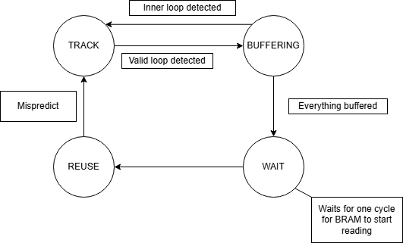
The FSM summarized

Slide 8


UOP CACHE
FSM
Responsible to source the later pipeline stages with stored small loops to be more cycle and power efficient
Implemented using one of Xilinx’s BRAMs.
BRAM

Slide 9
Reading
Writing
FSM
BRAM operating in SDP mode
Reading and writing using the correct bit and byte-wide enables
32-bit data split across 2 16-bits input and output ports
BRAM

Slide 10
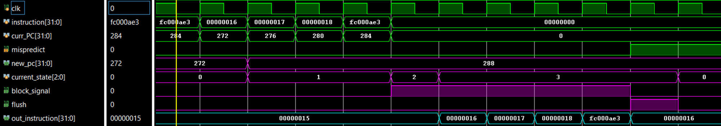
Post-Implementation Functional Simulation:

Slide 11
Fixing the reading from BRAM
4 extra Instructions
Because of branch misprediction and the flush that it produces we store 4 wrong instruction in the bram. To solve this we started reading from 4 instructions later. This way we start from the beggining of the loop.

Slide 12
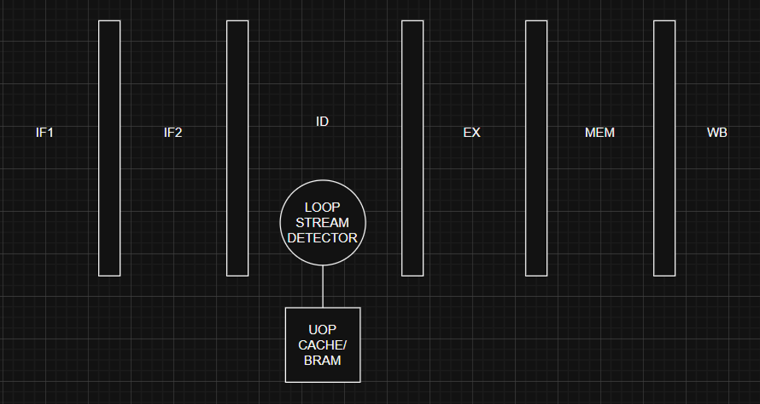
RISC-V

Slide 13
RISC-V Execution Codes
CASE 1:
Big Loop with 3 small subloops
CASE 2:
The Biggest Loop to test edge case
CASE 3:
One Instruction Loop to test edge cases
Link for writing assembly code

Slide 14
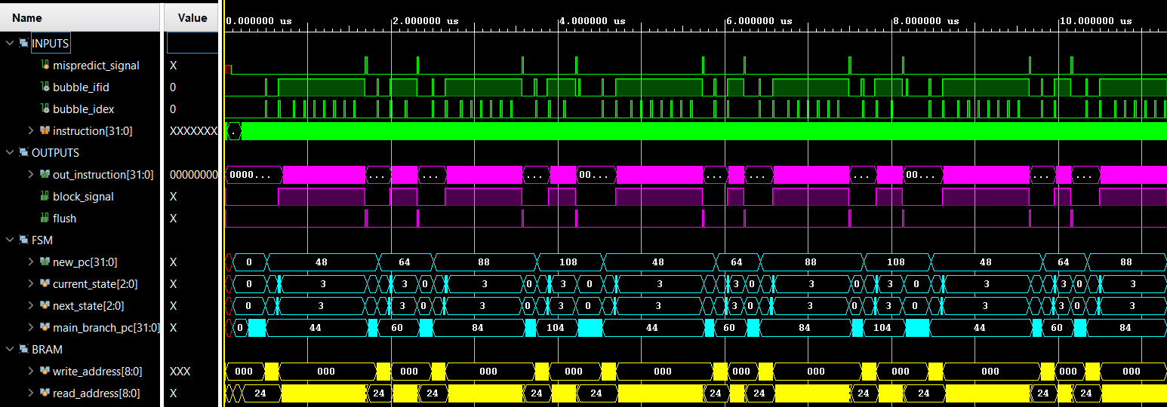
CASE 1

Slide 15
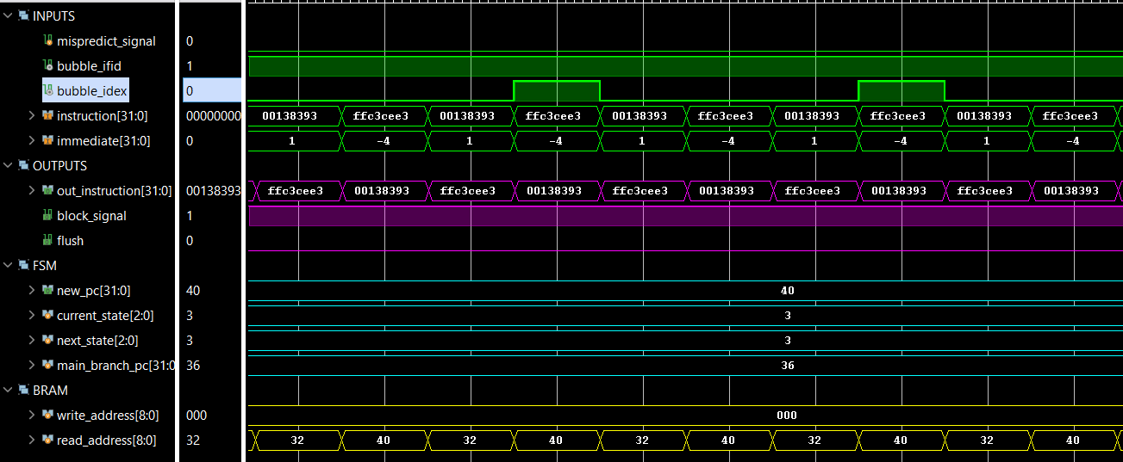
CASE 3

Slide 16
Parallel Computer Architecture
University of Thessaly
THANK YOU FOR YOUR ATTENTION
ANY
QUESTIONS?
STAVROS STATHOUDAKIS 03512
KONSTANTINOS ANDRIKOPOULOS 03649
STAMOULIS SPYRIDON 03775

